Slide 1

COVID VACCINATION and EDUCATION IN THE UNITED STATES- Influenza Vaccine
AYOMIDE
AHMED
KEHLANI
MUSE

Slide 2


Agenda
States with most deaths
Relationship between death rates and Vaccination rates
Vaccination rates according to demography for each state

Slide 3
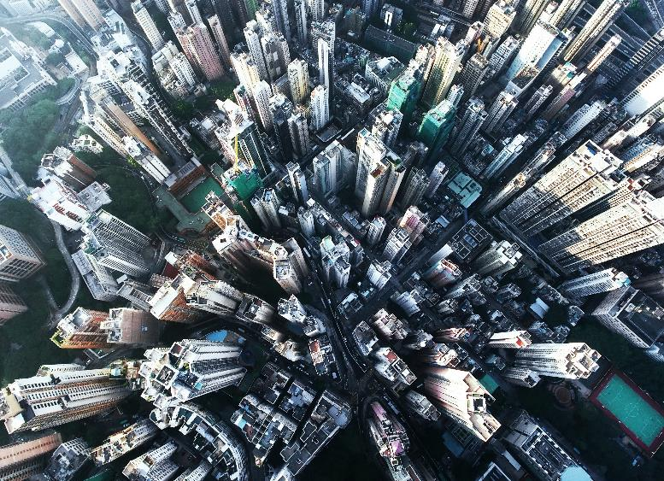

Introduction
Scenario:
The government wants to amplify the education around the need for covid vaccination to reduce the number of fatalities or severe cases in the US. They needs to know how to prioritize educative resources by demography. That is, they need to know what groups to focus on the most.
Research question:
This project aims to create a data visualization that the users (Government) can easily navigate through and derive their answers from.

Slide 4



DEATH RATES-
visualisation of states in the US and their death rates. Focusing on sates with the highest death rates

Slide 5
CHART

Slide 6
Table
 | Category 1 | Category 2 | Category 3 | Category 4
Item 1 | 4.5 | 2.3 | 1.7 | 5
Item 2 | 3.2 | 5.1 | 4.4 | 3
Item 3 | 2.1 | 1.7 | 2.5 | 2.8
Item 4 | 4.5 | 2.2 | 1.7 | 7

Slide 7

Relationship between death rates and Vaccination rates
So what do the vaccination rates look like in these states?

Slide 8




team
Name
Name
Name
Name
Title
Title
Title
Title

Slide 9
TIMELINE
Title
To start a presentation, go to the Slide Show tab, and select From Beginning.
Title
To start a presentation, go to the Slide Show tab, and select From Beginning.
Title
During your presentation, the speaker notes are visible on your monitor, but aren't visible to the audience.
Title
Title
The Notes pane is a box that appears below each slide. Tap it to add notes.
If you can’t see the Notes pane or it is completely minimised, click Notes on the task bar across the bottom of the PowerPoint window.

Slide 10
Vaccination rates according to demography for each state
Where do the government need to direct their awareness outreach to?

Slide 11
Content 2
Summary
summary
summary
Add text, images, art, and videos.
Add transitions, animations, and motion.
Save to OneDrive, to get to your presentations from your computer, tablet, or phone.
Open the Design Ideas pane for instant slide makeovers.
When we have design ideas, we’ll show them to you right there.
This PowerPoint theme uses its own unique set of colours, fonts and effects to create the overall look and feel of these slides.
PowerPoint has tons of themes to give your presentation just the right personality.

Slide 12




Summary
With PowerPoint, you can create presentations and share your work with others, wherever they are. Type the text you want here to get started. You can also add images, art, and videos on this template. Save to OneDrive and access your presentations from your computer, tablet, or phone.

Slide 13

Thank you

